Slide 1
Self-Balancing Search Trees
Chapter 11

Slide 2
Chapter Objectives
To understand the impact that balance has on the performance of binary search trees
To learn about the AVL tree for storing and maintaining a binary search tree in balance
To learn about the Red-Black tree for storing and maintaining a binary search tree in balance
To learn about 2-3 trees, 2-3-4 trees, and B-trees and how they achieve balance
To understand the process of search and insertion in each of these trees and to be introduced to removal

Slide 3
Self-Balancing Search Trees
The performance of a binary search tree is proportional to the height of the tree or the maximum number of nodes along a path from the root to a leaf
A full binary tree of height k can hold 2^{k} -1 items
If a binary search tree is full and contains n items, the expected performance is O(log n)
However, if a binary tree is not full, the actual performance is worse than expected
To solve this problem, we introduce self-balancing trees to achieve a balance so that the heights of the right and left subtrees are equal or nearly equal
We also look non-binary search trees: the B-tree and its specializations, the 2-3 and 2-3-4 trees, and the B+ tree

Slide 4
Tree Balance and Rotation
Section 11.1

Slide 5
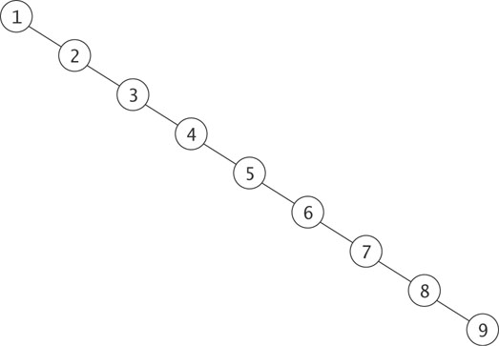
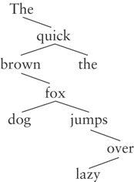
Why Balance is Important
Searches into this unbalanced search tree are O(n), not O(log n)
A realistic example of an unbalanced tree

Slide 6
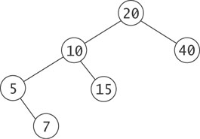
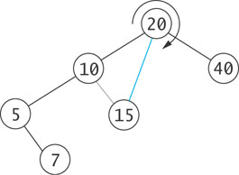
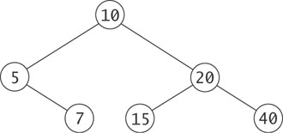
Rotation
We need an operation on a binary tree that changes the relative heights of left and right subtrees, but preserves the binary search tree property

Slide 7
Algorithm for Rotation
root
BTNode
= left
right =
data = 20
BTNode
BTNode
= left
right =
data = 10
= left
right =
data = 40
NULL
NULL
BTNode
BTNode
= left
right =
data = 5
= left
right =
data = 15
NULL
NULL
NULL
BTNode
= left
right =
data = 7
NULL
NULL

Slide 8
Algorithm for Rotation (cont.)
root
BTNode
temp
= left
right =
data = 20
BTNode
BTNode
= left
right =
data = 10
= left
right =
data = 40
NULL
NULL
BTNode
BTNode
Remember value of root->left (temp = root->left)
= left
right =
data = 5
= left
right =
data = 15
NULL
NULL
NULL
BTNode
= left
right =
data = 7
NULL
NULL

Slide 9
Algorithm for Rotation (cont.)
root
BTNode
temp
= left
right =
data = 20
BTNode
BTNode
= left
right =
data = 10
= left
right =
data = 40
NULL
NULL
BTNode
BTNode
Remember value of root->left (temp = root->left)
Set root->left to value of temp->right
= left
right =
data = 5
= left
right =
data = 15
NULL
NULL
NULL
BTNode
= left
right =
data = 7
NULL
NULL

Slide 10
Algorithm for Rotation (cont.)
root
BTNode
temp
= left
right =
data = 20
BTNode
BTNode
= left
right =
data = 10
= left
right =
data = 40
NULL
NULL
BTNode
BTNode
Remember value of root->left (temp = root->left)
Set root->left to value of temp->right
Set temp->right to root
= left
right =
data = 5
= left
right =
data = 15
NULL
NULL
NULL
BTNode
= left
right =
data = 7
NULL
NULL

Slide 11
Algorithm for Rotation (cont.)
root
BTNode
temp
= left
right =
data = 20
BTNode
BTNode
= left
right =
data = 10
= left
right =
data = 40
NULL
NULL
BTNode
BTNode
Remember value of root->left (temp = root->left)
Set root->left to value of temp->right
Set temp->right to root
Set root to temp
= left
right =
data = 5
= left
right =
data = 15
NULL
NULL
NULL
BTNode
= left
right =
data = 7
NULL
NULL

Slide 12
Algorithm for Rotation (cont.)
root
BTNode
= left
right =
data = 10
BTNode
BTNode
= left
right =
data = 5
= left
right =
data = 20
NULL
BTNode
BTNode
BTNode
= left
right =
data = 7
= left
right =
data = 15
= left
right =
data = 40
NULL
NULL
NULL
NULL
NULL
NULL

Slide 13
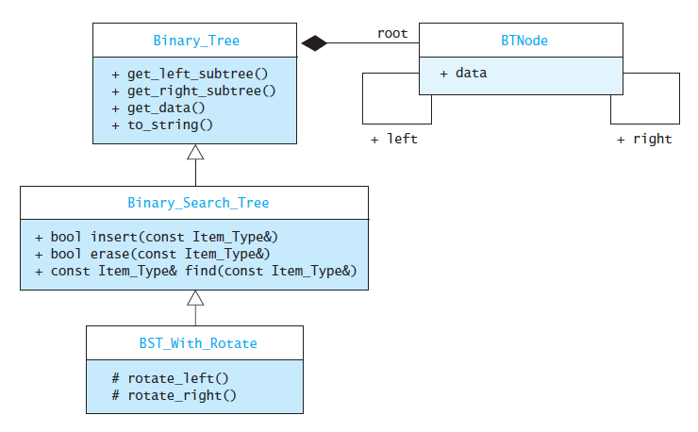
Implementing Rotation

Slide 14
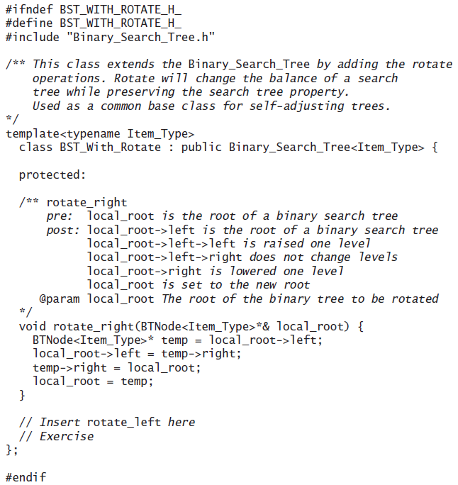
Implementing Rotation (cont.)

Slide 15
AVL Trees
Section 11.2

Slide 16
AVL Trees
In 1962 G.M. Adel'son-Vel'skiî and E.M. Landis developed a self-balancing tree. The tree is known by their initials: AVL
The AVL tree algorithm keeps track of the difference in height of each subtree
As items are added to or removed from a tree, the balance of each subtree from the insertion or removal point up to the root is updated
If the balance gets out of the range -1 to +1, the tree is rotated to bring it back into range

Slide 17
Balancing a Left-Left Tree
50
25
c
a
b
Each light purple triangle represents a tree of height k

Slide 18
Balancing a Left-Left Tree (cont.)
50
25
c
a
b
The dark purple trapezoid represents an insertion into this tree, making its height k + 1

Slide 19
Balancing a Left-Left Tree (cont.)
The heights of the left and right subtrees are unimportant; only the relative difference matters when balancing
50
k – (k + 2)
-2
25
c
k - (k + 1)
-1
a
b
The formula h_{R} – h_{L} is used to calculate the balance of each node

Slide 20
Balancing a Left-Left Tree (cont.)
When the root and left subtree are both left-heavy, the tree is called a Left-Left tree
50
-2
25
c
-1
a
b

Slide 21
Balancing a Left-Left Tree (cont.)
A Left-Left tree can be balanced by a rotation right
50
-2
25
c
-1
a
b

Slide 22
Balancing a Left-Left Tree (cont.)
25
0
a
50
0
b
c

Slide 23
Balancing a Left-Left Tree (cont.)
Even after insertion, the overall height has not increased

Slide 24
Balancing a Left-Right Tree
k - (k + 2)
50
-2
25
c
+1
(k + 1) - k
a
b

Slide 25
Balancing a Left-Right Tree (cont.)
50
-2
25
c
+1
a
b
A Left-Right tree cannot be balanced by a simple rotation right

Slide 26
Balancing a Left-Right Tree (cont.)
50
-2
25
c
+1
a
b
Subtree b needs to be expanded into its subtrees b_{L} and b_{R}

Slide 27
Balancing a Left-Right Tree (cont.)
50
-2
25
c
+1
a
40
-1
40 is left-heavy. The left subtree now can be rotated left
b_{L}
b_{R}

Slide 28
Balancing a Left-Right Tree (cont.)
50
-2
40
c
-2
25
0
b_{R}
The overall tree is now Left-Left and a rotation right will balance it.
a
b_{L}

Slide 29
Balancing a Left-Right Tree (cont.)
40
0
25
50
+1
0
a
c
b_{L}
b_{R}

Slide 30
Balancing a Left-Right Tree (cont.)
50
-2
25
c
+1
a
40
+1
In the previous example, an item was inserted in b_{L.}
We now show the steps when an item is inserted into b_{R} instead
b_{L}
b_{R}

Slide 31
Balancing a Left-Right Tree (cont.)
50
-2
25
c
+1
a
40
+1
Rotate the left subtree left
b_{L}
b_{R}

Slide 32
Balancing a Left-Right Tree (cont.)
Rotate the tree right
50
-2
40
-1
c
25
-1
a
b_{R}
b_{L}

Slide 33
Balancing a Left-Right Tree (cont.)
40
0
25
50
-1
0
a
c
b_{L}
b_{R}

Slide 34
Four Kinds of Critically Unbalanced Trees
Left-Left (parent balance is -2, left child balance is -1)
Rotate right around parent
Left-Right (parent balance -2, left child balance +1)
Rotate left around child
Rotate right around parent
Right-Right (parent balance +2, right child balance +1)
Rotate left around parent
Right-Left (parent balance +2, right child balance -1)
Rotate right around child
Rotate left around parent

Slide 35
AVL Tree Example
Build an AVL tree from the words in "The quick brown fox jumps over the lazy dog"

Slide 36
AVL Tree Example (cont.)
The
+2
quick
-1
brown
0
The overall tree is right-heavy (Right-Left) parent balance = +2
right child balance = -1

Slide 37
AVL Tree Example (cont.)
The
+2
quick
-1
brown
0
Rotate right around the child

Slide 38
AVL Tree Example (cont.)
The
+2
brown
+1
quick
0
Rotate right around the child

Slide 39
AVL Tree Example (cont.)
The
+2
brown
+1
quick
0
Rotate right around the child
Rotate left around the parent

Slide 40
AVL Tree Example (cont.)
brown
0
The
0
quick
0
Rotate right around the child
Rotate left around the parent

Slide 41
AVL Tree Example (cont.)
brown
0
Insert fox
The
0
quick
0

Slide 42
AVL Tree Example (cont.)
brown
+1
Insert fox
The
0
quick
-1
fox
0

Slide 43
AVL Tree Example (cont.)
brown
+1
Insert jumps
The
0
quick
-1
fox
0

Slide 44
AVL Tree Example (cont.)
brown
+2
Insert jumps
The
0
quick
-2
fox
+1
jumps
0

Slide 45
AVL Tree Example (cont.)
brown
+2
The
0
quick
-2
fox
+1
jumps
0
The tree is now left-heavy about quick (Left-Right case)

Slide 46
AVL Tree Example (cont.)
brown
+2
The
0
quick
-2
fox
+1
jumps
0
Rotate left around the child

Slide 47
AVL Tree Example (cont.)
brown
+2
The
0
quick
-2
jumps
-1
fox
0
Rotate left around the child

Slide 48
AVL Tree Example (cont.)
brown
+2
The
0
quick
-2
jumps
-1
fox
0
Rotate left around the child
Rotate right around the parent

Slide 49
AVL Tree Example (cont.)
brown
+1
The
0
jumps
0
fox
0
quick
0
Rotate left around the child
Rotate right around the parent

Slide 50
AVL Tree Example (cont.)
brown
+1
Insert over
The
0
jumps
0
fox
0
quick
0

Slide 51
AVL Tree Example (cont.)
brown
+2
Insert over
The
0
jumps
+1
fox
0
quick
-1
over
0

Slide 52
AVL Tree Example (cont.)
brown
+2
The
0
jumps
+1
fox
0
quick
-1
over
0
We now have a Right-Right imbalance

Slide 53
AVL Tree Example (cont.)
brown
+2
The
0
jumps
+1
fox
0
quick
-1
over
0
1. Rotate left around the parent

Slide 54
AVL Tree Example (cont.)
jumps
0
brown
0
quick
-1
The
0
fox
0
over
0
1. Rotate left around the parent

Slide 55
AVL Tree Example (cont.)
jumps
0
Insert the
brown
0
quick
-1
The
0
fox
0
over
0

Slide 56
AVL Tree Example (cont.)
jumps
0
Insert the
brown
0
quick
0
The
0
fox
0
over
0
the
0

Slide 57
AVL Tree Example (cont.)
jumps
0
Insert lazy
brown
0
quick
0
The
0
fox
0
over
0
the
0

Slide 58
AVL Tree Example (cont.)
jumps
+1
Insert lazy
brown
0
quick
-1
The
0
fox
0
over
-1
the
0
lazy
0

Slide 59
AVL Tree Example (cont.)
jumps
+1
Insert dog
brown
0
quick
-1
The
0
fox
0
over
-1
the
0
lazy
0

Slide 60
AVL Tree Example (cont.)
jumps
0
Insert dog
brown
+1
quick
-1
The
0
fox
-1
over
-1
the
0
dog
0
lazy
0

Slide 61
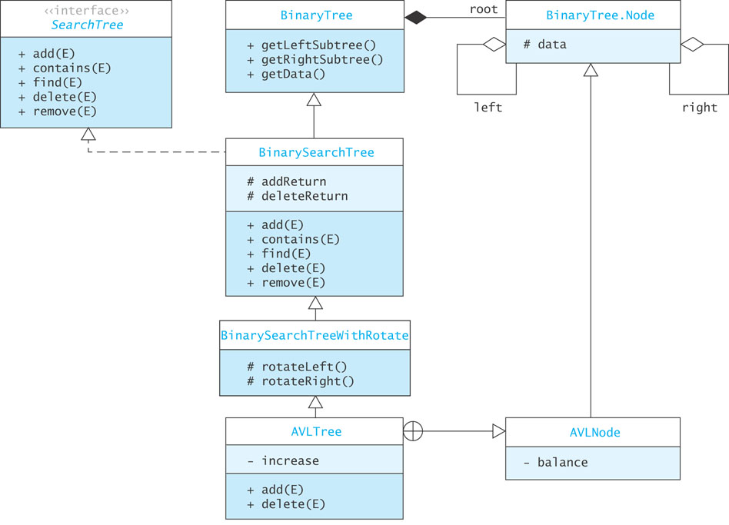
Implementing an AVL Tree

Slide 62
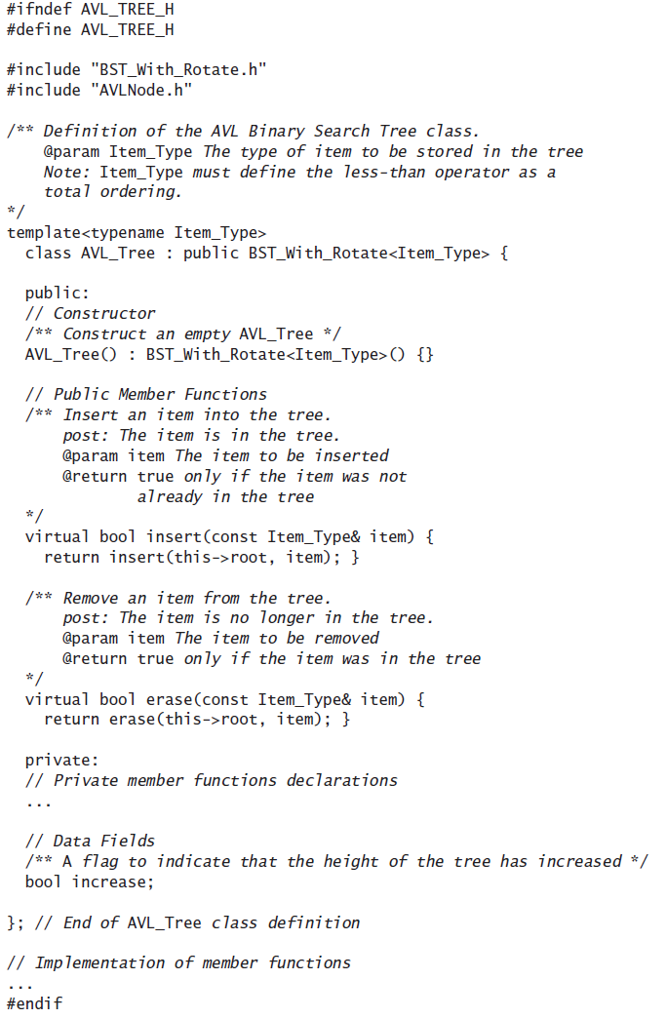
Implementing an AVL Tree (cont.)

Slide 63
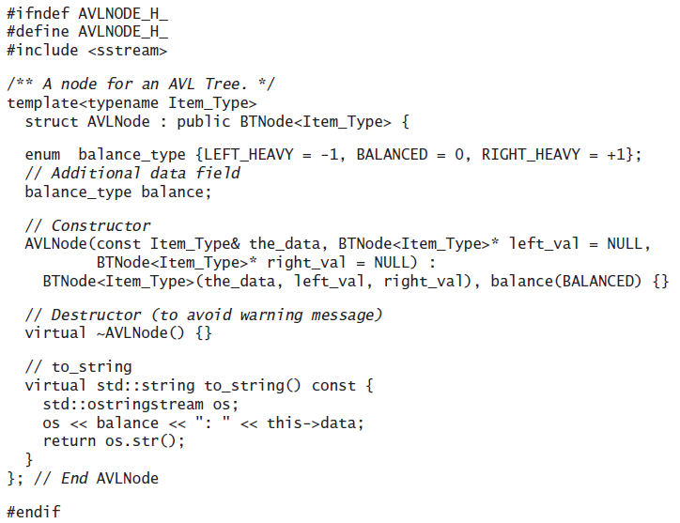
The AVLNode Class

Slide 64
Inserting into an AVL Tree
The easiest way to keep a tree balanced is never to let it remain critically unbalanced
If any node becomes critical, rebalance immediately
Identify critical nodes by checking the balance at the root node as you return along the insertion path

Slide 65
Inserting into an AVL Tree (cont.)
Algorithm for Insertion into an AVL Tree
1. if the root is NULL
2. Create a new tree with the item at the root and return true
else if the item is equal to root->data
3. The item is already in the tree; return false
else if the item is less than root->data
4. Recursively insert the item in the left subtree.
5. if the height of the left subtree has increased (increase is true)
6. Decrement balance
7. if balance is zero, reset increase to false
8. if balance is less than –1
9. Reset increase to false.
10. Perform a rebalance_left
else if the item is greater than root->data
11. The processing is symmetric to Steps 4 through 10. Note that balance
is incremented if increase is true.

Slide 66
Recursive insert Function
The recursive insert function is called by the insert starter function (see the AVL_Tree Class Definition)
/** Insert an item into the tree.
post: The item is in the tree.
@param local_root A reference to the current root
@param item The item to be inserted
@return true only if the item was not already in the tree
*/
virtual bool insert(BTNode<Item_Type>*& local_root,
const Item_Type& item) {
if (local_root == NULL) {
local_root = new AVLNode<Item_Type>(item);
increase = true;
return true;
}

Slide 67
Recursive insert Function (cont.)
if (item < local_root->data) {
bool return_value = insert(local_root->left, item);
if (increase) {
AVLNode<Item_Type>* AVL_local_root =
dynamic_cast<AVLNode<Item_Type>*>(local_root);
switch (AVL_local_root->balance) {
case AVLNode<Item_Type>::BALANCED :
// local root is now left heavy
AVL_local_root->balance =
AVLNode<Item_Type>::LEFT_HEAVY;
break;
case AVLNode<Item_Type>::RIGHT_HEAVY :
// local root is now right heavy
AVL_local_root->balance = AVLNode<Item_Type>::BALANCED;
// Overall height of local root remains the same
increase = false;
break;

Slide 68
Recursive insert Function (cont.)
case AVLNode<Item_Type>::LEFT_HEAVY :
// local root is now critically unbalanced
rebalance_left(local_root);
increase = false;
break;
} // End switch
} // End (if increase)
return return_value
} // End (if item <local_root->data)
else {
increase = false
return false;
}

Slide 69
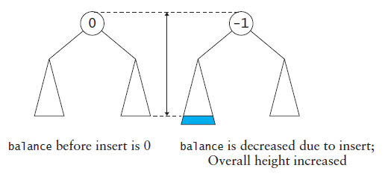
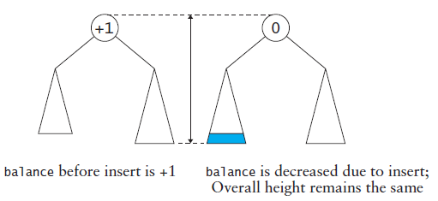
Recursive insert Function (cont.)

Slide 70
Initial Algorithm for rebalance_left
Initial Algorithm for rebalanceLeft
1. if the left subtree has positive balance (Left-Right case)
2. Rotate left around left subtree root.
3. Rotate right.

Slide 71
Effect of Rotations on Balance
The rebalance algorithm on the previous slide is incomplete as the balance of the nodes has not been adjusted
For a Left-Left tree the balances of the new root node and of its right child are 0 after a right rotation
Left-Right is more complicated:
the balance of the root is 0

Slide 72
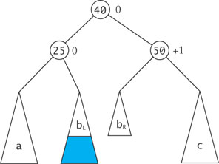
Effect of Rotations on Balance (cont.)
if the critically unbalanced situation was due to an insertion into
subtree b_{L} (Left-Right-Left case), the balance of the root's left child is 0 and the balance of the root's right child is +1

Slide 73
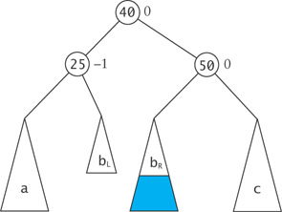
Effect of Rotations on Balance (cont.)
if the critically unbalanced situation was due to an insertion into
subtree b_{R} (Left-Right-Right case), the balance of the root's left child is -1 and the balance of the root's right child is 0

Slide 74
Revised Algorithm for rebalance_left
Revised Algorithm for rebalance_left
if the left subtree has a positive balance (Left-Right case)
if the left-right subtree has a negative balance (Left-Right-Left case)
Set the left subtree (new left subtree) balance to 0
Set the left-left subtree (new root) balance to 0
Set the local root (new right subtree) balance to +1
else if the left-right subtree has a positive balance (Left-Right-Right case)
Set the left subtree (new left subtree) balance to –1
Set the left-left subtree (new root) balance to 0
Set the local root (new right subtree) balance to 0
else (Left-Right Balanced case)
Set the left subtree (new left subtree) balance to 0
Set the left-left subtree (new root) balance to 0
Set the local root (new right subtree) balance to 0
Rotate the left subtree left
else (Left-Left case)
Set the left subtree balance to 0
Set the local root balance to 0
Rotate the local root right

Slide 75
Revised Algorithm for rebalance_left (cont.)
(on the previous slide) lines 4, 8, and 12 should say, “set the left-right subtree” instead of “set the left-left subtree”

Slide 76
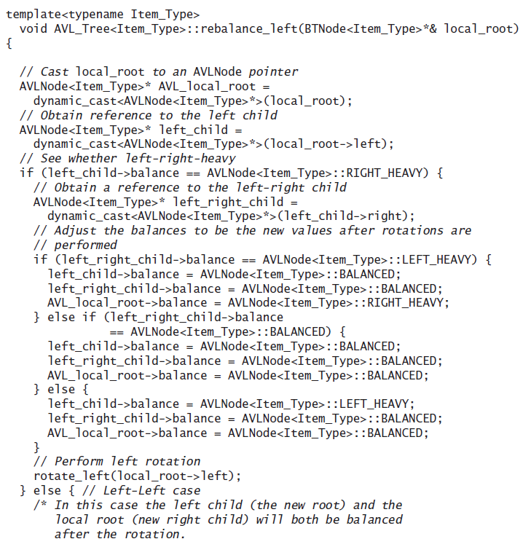
Function rebalance_left

Slide 77
Removal from an AVL Tree
Removal
from a left subtree, increases the balance of the local root
from a right subtree, decreases the balance of the local root
The binary search tree removal function can be adapted for removal from an AVL tree
A data field decrease tells the previous level in the recursion that there was a decrease in the height of the subtree from which the return occurred
The local root balance is incremented or decremented based on this field
If the balance is outside the threshold, a rebalance function is called to restore balance

Slide 78
Removal from an AVL Tree (cont.)
Functions rebalance_left, and rebalance_right need to be modified so that they set the balance value correctly if the left (or right) subtree is balanced
When a subtree changes from either left-heavy or right-heavy to balanced, then the height has decreased, and decrease should remain true
When the subtree changes from balanced to either left-heavy or right-heavy, then decrease should be reset to false
Each recursive return can result in a further need to rebalance

Slide 79
Performance of the AVL Tree
Since each subtree is kept close to balanced, the AVL has expected O(log n)
Each subtree is allowed to be out of balance ±1 so the tree may contain some holes
In the worst case (which is rare) an AVL tree can be 1.44 times the height of a full binary tree that contains the same number of items
Ignoring constants, this still yields O(log n) performance
Empirical tests show that on average log₂n + 0.25 comparisons are required to insert the nth item into an AVL tree – close to insertion into a corresponding complete binary search tree

Slide 80
Red-Black Trees
Section 11.3

Slide 81
Red-Black Trees
Rudolf Bayer developed the Red-Black tree as a special case of his B-tree
Leo Guibas and Robert Sedgewick refined the concept and introduced the color convention

Slide 82
Red-Black Trees (cont.)
A Red-Black tree maintains the following invariants:
A node is either red or black
The root is always black
A red node always has black children (a NULL pointer is considered to refer to a black node)
The number of black nodes in any path from the root to a leaf is the same
11
2
14
1
7
5
8

Slide 83
Red-Black Trees (cont.)
Height is determined by counting only black nodes
A Red-Black tree is always balanced because the root node’s left and right subtrees must be the same height
By the standards of the AVL tree this tree is out of balance and would be considered a Left-Right tree
However, by the standards of the Red-Black tree it is balanced, because there are two black nodes (counting the root) in any path from the root to a leaf
11
2
14
1
7
5
8

Slide 84
Insertion into a Red-Black Tree
The algorithm follows the same recursive search process used for all binary search trees to reach the insertion point
When a leaf position is found, the new item is inserted and initially given the color red
If the parent is black, we are done; otherwise there is some rearranging to do
We introduce three situations ("cases") that may occur when a node is inserted; more than one can occur after an insertion

Slide 85
Insertion into a Red-Black Tree (cont.)
CASE 1
Invariants:
A node is either red or black
The root is always black
A red node always has black children (a NULL pointer is considered to refer to a black node)
The number of black nodes in any path from the root to a leaf is the same
20
10
30

Slide 86
Insertion into a Red-Black Tree (cont.)
CASE 1
Invariants:
A node is either red or black
The root is always black
A red node always has black children (a NULL pointer is considered to refer to a black node)
The number of black nodes in any path from the root to a leaf is the same
20
10
30
35
If a parent is red, and its sibling is also red, they can both be changed to black, and the grandparent to red

Slide 87
Insertion into a Red-Black Tree (cont.)
CASE 1
Invariants:
A node is either red or black
The root is always black
A red node always has black children (a NULL pointer is considered to refer to a black node)
The number of black nodes in any path from the root to a leaf is the same
20
10
30
35
If a parent is red, and its sibling is also red, they can both be changed to black, and the grandparent to red

Slide 88
Insertion into a Red-Black Tree (cont.)
CASE 1
Invariants:
A node is either red or black
The root is always black
A red node always has black children (a NULL pointer is considered to refer to a black node)
The number of black nodes in any path from the root to a leaf is the same
20
10
30
35
The root can be changed to black and still maintain invariant 4

Slide 89
Insertion into a Red-Black Tree (cont.)
CASE 1
Invariants:
A node is either red or black
The root is always black
A red node always has black children (a NULL pointer is considered to refer to a black node)
The number of black nodes in any path from the root to a leaf is the same
20
10
30
35
The root can be changed to black and still maintain invariant 4

Slide 90
Insertion into a Red-Black Tree (cont.)
CASE 1
Invariants:
A node is either red or black
The root is always black
A red node always has black children (a NULL pointer is considered to refer to a black node)
The number of black nodes in any path from the root to a leaf is the same
20
10
30
35
Balanced tree

Slide 91
Insertion into a Red-Black Tree (cont.)
CASE 2
Invariants:
A node is either red or black
The root is always black
A red node always has black children (a NULL pointer is considered to refer to a black node)
The number of black nodes in any path from the root to a leaf is the same
20
30

Slide 92
Insertion into a Red-Black Tree (cont.)
CASE 2
Invariants:
A node is either red or black
The root is always black
A red node always has black children (a NULL pointer is considered to refer to a black node)
The number of black nodes in any path from the root to a leaf is the same
20
30
35
If a parent is red (with no sibling), it can be changed to black, and the grandparent to red

Slide 93
Insertion into a Red-Black Tree (cont.)
CASE 2
Invariants:
A node is either red or black
The root is always black
A red node always has black children (a NULL pointer is considered to refer to a black node)
The number of black nodes in any path from the root to a leaf is the same
20
30
35
If a parent is red (with no sibling), it can be changed to black, and the grandparent to red

Slide 94
Insertion into a Red-Black Tree (cont.)
CASE 2
Invariants:
A node is either red or black
The root is always black
A red node always has black children (a NULL pointer is considered to refer to a black node)
The number of black nodes in any path from the root to a leaf is the same
20
30
35
There is one black node on the right and none on the left, which violates invariant 4

Slide 95
Insertion into a Red-Black Tree (cont.)
CASE 2
Invariants:
A node is either red or black
The root is always black
A red node always has black children (a NULL pointer is considered to refer to a black node)
The number of black nodes in any path from the root to a leaf is the same
20
30
35
Rotate left around the grandparent to correct this

Slide 96
Insertion into a Red-Black Tree (cont.)
CASE 2
Invariants:
A node is either red or black
The root is always black
A red node always has black children (a NULL pointer is considered to refer to a black node)
The number of black nodes in any path from the root to a leaf is the same
30
20
35
Rotate left around the grandparent to correct this

Slide 97
Insertion into a Red-Black Tree (cont.)
CASE 2
Invariants:
A node is either red or black
The root is always black
A red node always has black children (a NULL pointer is considered to refer to a black node)
The number of black nodes in any path from the root to a leaf is the same
30
20
35
Balanced tree

Slide 98
Insertion into a Red-Black Tree (cont.)
CASE 3
Invariants:
A node is either red or black
The root is always black
A red node always has black children (a NULL pointer is considered to refer to a black node)
The number of black nodes in any path from the root to a leaf is the same
20
30

Slide 99
Insertion into a Red-Black Tree (cont.)
CASE 3
Invariants:
A node is either red or black
The root is always black
A red node always has black children (a NULL pointer is considered to refer to a black node)
The number of black nodes in any path from the root to a leaf is the same
20
30
25
If a parent is red (with no sibling), it can be changed to black, and the grandparent to red

Slide 100
Insertion into a Red-Black Tree (cont.)
CASE 3
Invariants:
A node is either red or black
The root is always black
A red node always has black children (a NULL pointer is considered to refer to a black node)
The number of black nodes in any path from the root to a leaf is the same
20
30
25
If a parent is red (with no sibling), it can be changed to black, and the grandparent to red

Slide 101
Insertion into a Red-Black Tree (cont.)
CASE 3
Invariants:
A node is either red or black
The root is always black
A red node always has black children (a NULL pointer is considered to refer to a black node)
The number of black nodes in any path from the root to a leaf is the same
20
30
25
A rotation left does not fix the violation of #4

Slide 102
Insertion into a Red-Black Tree (cont.)
CASE 3
Invariants:
A node is either red or black
The root is always black
A red node always has black children (a NULL pointer is considered to refer to a black node)
The number of black nodes in any path from the root to a leaf is the same
30
20
25
A rotation left does not fix the violation of #4

Slide 103
Insertion into a Red-Black Tree (cont.)
CASE 3
Invariants:
A node is either red or black
The root is always black
A red node always has black children (a NULL pointer is considered to refer to a black node)
The number of black nodes in any path from the root to a leaf is the same
20
30
25
Back-up to the beginning (don't perform rotation or change colors)

Slide 104
Insertion into a Red-Black Tree (cont.)
CASE 3
Invariants:
A node is either red or black
The root is always black
A red node always has black children (a NULL pointer is considered to refer to a black node)
The number of black nodes in any path from the root to a leaf is the same
20
30
25
Rotate right about the parent so that the red child is on the same side of the parent as the parent is to the grandparent

Slide 105
Insertion into a Red-Black Tree (cont.)
CASE 3
Invariants:
A node is either red or black
The root is always black
A red node always has black children (a NULL pointer is considered to refer to a black node)
The number of black nodes in any path from the root to a leaf is the same
20
25
30
Rotate right about the parent so that the red child is on the same side of the parent as the parent is to the grandparent

Slide 106
Insertion into a Red-Black Tree (cont.)
CASE 3
Invariants:
A node is either red or black
The root is always black
A red node always has black children (a NULL pointer is considered to refer to a black node)
The number of black nodes in any path from the root to a leaf is the same
20
25
30
NOW, change colors

Slide 107
Insertion into a Red-Black Tree (cont.)
CASE 3
Invariants:
A node is either red or black
The root is always black
A red node always has black children (a NULL pointer is considered to refer to a black node)
The number of black nodes in any path from the root to a leaf is the same
20
25
30
NOW, change colors

Slide 108
Insertion into a Red-Black Tree (cont.)
CASE 3
Invariants:
A node is either red or black
The root is always black
A red node always has black children (a NULL pointer is considered to refer to a black node)
The number of black nodes in any path from the root to a leaf is the same
20
25
30
and rotate left . . .

Slide 109
Insertion into a Red-Black Tree (cont.)
CASE 3
Invariants:
A node is either red or black
The root is always black
A red node always has black children (a NULL pointer is considered to refer to a black node)
The number of black nodes in any path from the root to a leaf is the same
25
20
30
and rotate left. . .

Slide 110
Insertion into a Red-Black Tree (cont.)
CASE 3
Invariants:
A node is either red or black
The root is always black
A red node always has black children (a NULL pointer is considered to refer to a black node)
The number of black nodes in any path from the root to a leaf is the same
25
20
30
Balanced tree

Slide 111
Insertion into a Red-Black Tree (cont.)
Invariants:
A node is either red or black
The root is always black
A red node always has black children (a NULL pointer is considered to refer to a black node)
The number of black nodes in any path from the root to a leaf is the same
11
2
14
1
7
5
8

Slide 112
Insertion into a Red-Black Tree (cont.)
Invariants:
A node is either red or black
The root is always black
A red node always has black children (a NULL pointer is considered to refer to a black node)
The number of black nodes in any path from the root to a leaf is the same
11
2
14
1
7
5
8
4

Slide 113
Insertion into a Red-Black Tree (cont.)
Invariants:
A node is either red or black
The root is always black
A red node always has black children (a NULL pointer is considered to refer to a black node)
The number of black nodes in any path from the root to a leaf is the same
11
2
14
1
7
CASE 1
5
8
If a parent is red, and its sibling is also red, they can both be changed to black, and the grandparent to red
4

Slide 114
Insertion into a Red-Black Tree (cont.)
Invariants:
A node is either red or black
The root is always black
A red node always has black children (a NULL pointer is considered to refer to a black node)
The number of black nodes in any path from the root to a leaf is the same
11
2
14
1
7
CASE 1
5
8
If a parent is red, and its sibling is also red, they can both be changed to black, and the grandparent to red
4

Slide 115
Insertion into a Red-Black Tree (cont.)
Invariants:
A node is either red or black
The root is always black
A red node always has black children (a NULL pointer is considered to refer to a black node)
The number of black nodes in any path from the root to a leaf is the same
11
2
14
1
7
5
8
The problem has now shifted up the tree
4

Slide 116
Insertion into a Red-Black Tree (cont.)
Invariants:
A node is either red or black
The root is always black
A red node always has black children (a NULL pointer is considered to refer to a black node)
The number of black nodes in any path from the root to a leaf is the same
11
2
14
1
7
CASE 3
5
8
We cannot change 2 to black because its sibling 14 is already black (both siblings have to be red unless there is no sibling) to do the color change
4

Slide 117
Insertion into a Red-Black Tree (cont.)
Invariants:
A node is either red or black
The root is always black
A red node always has black children (a NULL pointer is considered to refer to a black node)
The number of black nodes in any path from the root to a leaf is the same
11
2
14
1
7
CASE 3
5
8
We need to rotate left around 2 so that the red child is on the same side of the parent as the parent is to the grandparent
4

Slide 118
Insertion into a Red-Black Tree (cont.)
Invariants:
A node is either red or black
The root is always black
A red node always has black children (a NULL pointer is considered to refer to a black node)
The number of black nodes in any path from the root to a leaf is the same
11
7
14
2
8
CASE 3
1
5
We need to rotate left around 2 so that the red child is on the same side of the parent as the parent is to the grandparent
4

Slide 119
Insertion into a Red-Black Tree (cont.)
Invariants:
A node is either red or black
The root is always black
A red node always has black children (a NULL pointer is considered to refer to a black node)
The number of black nodes in any path from the root to a leaf is the same
11
7
14
2
8
CASE 3
1
5
Change colors
4

Slide 120
Insertion into a Red-Black Tree (cont.)
Invariants:
A node is either red or black
The root is always black
A red node always has black children (a NULL pointer is considered to refer to a black node)
The number of black nodes in any path from the root to a leaf is the same
11
7
14
2
8
CASE 3
1
5
Change colors
4

Slide 121
Insertion into a Red-Black Tree (cont.)
Invariants:
A node is either red or black
The root is always black
A red node always has black children (a NULL pointer is considered to refer to a black node)
The number of black nodes in any path from the root to a leaf is the same
11
7
14
2
8
CASE 3
1
5
Rotate right around 11 to restore the balance
4

Slide 122
Insertion into a Red-Black Tree (cont.)
Invariants:
A node is either red or black
The root is always black
A red node always has black children (a NULL pointer is considered to refer to a black node)
The number of black nodes in any path from the root to a leaf is the same
7
2
11
1
5
8
14
CASE 3
4
Rotate right around 11 to restore the balance

Slide 123
Insertion into a Red-Black Tree (cont.)
Invariants:
A node is either red or black
The root is always black
A red node always has black children (a NULL pointer is considered to refer to a black node)
The number of black nodes in any path from the root to a leaf is the same
7
2
11
1
5
8
14
4
Balanced tree

Slide 124
Red-Black Tree Example
Build a Red-Black tree for the words in "The quick brown fox jumps over the lazy dog"

Slide 125
Red-Black Tree Example (cont.)
Invariants:
A node is either red or black
The root is always black
A red node always has black children (a NULL pointer is considered to refer to a black node)
The number of black nodes in any path from the root to a leaf is the same
The
quick

Slide 126
Red-Black Tree Example (cont.)
Invariants:
A node is either red or black
The root is always black
A red node always has black children (a NULL pointer is considered to refer to a black node)
The number of black nodes in any path from the root to a leaf is the same
The
quick
brown
CASE 3
Rotate so that the child is on the same side of its parent as its parent is to the grandparent

Slide 127
Red-Black Tree Example (cont.)
Invariants:
A node is either red or black
The root is always black
A red node always has black children (a NULL pointer is considered to refer to a black node)
The number of black nodes in any path from the root to a leaf is the same
The
brown
quick
CASE 3
Change colors

Slide 128
Red-Black Tree Example (cont.)
Invariants:
A node is either red or black
The root is always black
A red node always has black children (a NULL pointer is considered to refer to a black node)
The number of black nodes in any path from the root to a leaf is the same
The
brown
quick
CASE 3
Change colors

Slide 129
Red-Black Tree Example (cont.)
Invariants:
A node is either red or black
The root is always black
A red node always has black children (a NULL pointer is considered to refer to a black node)
The number of black nodes in any path from the root to a leaf is the same
The
brown
quick
CASE 3
Rotate left

Slide 130
Red-Black Tree Example (cont.)
Invariants:
A node is either red or black
The root is always black
A red node always has black children (a NULL pointer is considered to refer to a black node)
The number of black nodes in any path from the root to a leaf is the same
brown
The
quick

Slide 131
Red-Black Tree Example (cont.)
Invariants:
A node is either red or black
The root is always black
A red node always has black children (a NULL pointer is considered to refer to a black node)
The number of black nodes in any path from the root to a leaf is the same
brown
The
quick
fox

Slide 132
Red-Black Tree Example (cont.)
Invariants:
A node is either red or black
The root is always black
A red node always has black children (a NULL pointer is considered to refer to a black node)
The number of black nodes in any path from the root to a leaf is the same
brown
The
quick
fox
CASE 1
fox's parent and its parent's sibling are both red. Change colors.

Slide 133
Red-Black Tree Example (cont.)
Invariants:
A node is either red or black
The root is always black
A red node always has black children (a NULL pointer is considered to refer to a black node)
The number of black nodes in any path from the root to a leaf is the same
brown
The
quick
fox
CASE 1
fox's parent and its parent's sibling are both red. Change colors.

Slide 134
Red-Black Tree Example (cont.)
Invariants:
A node is either red or black
The root is always black
A red node always has black children (a NULL pointer is considered to refer to a black node)
The number of black nodes in any path from the root to a leaf is the same
brown
The
quick
fox
CASE 1
We can change brown's color to black and not violate #4

Slide 135
Red-Black Tree Example (cont.)
Invariants:
A node is either red or black
The root is always black
A red node always has black children (a NULL pointer is considered to refer to a black node)
The number of black nodes in any path from the root to a leaf is the same
brown
The
quick
fox
CASE 1
We can change brown's color to black and not violate #4

Slide 136
Red-Black Tree Example (cont.)
Invariants:
A node is either red or black
The root is always black
A red node always has black children (a NULL pointer is considered to refer to a black node)
The number of black nodes in any path from the root to a leaf is the same
brown
The
quick
fox
jumps

Slide 137
Red-Black Tree Example (cont.)
Invariants:
A node is either red or black
The root is always black
A red node always has black children (a NULL pointer is considered to refer to a black node)
The number of black nodes in any path from the root to a leaf is the same
brown
The
quick
fox
jumps
CASE 3
Rotate so that red child is on same side of its parent as its parent is to the grandparent

Slide 138
Red-Black Tree Example (cont.)
Invariants:
A node is either red or black
The root is always black
A red node always has black children (a NULL pointer is considered to refer to a black node)
The number of black nodes in any path from the root to a leaf is the same
brown
The
quick
jumps
fox
CASE 3
Change fox's parent and grandparent colors

Slide 139
Red-Black Tree Example (cont.)
Invariants:
A node is either red or black
The root is always black
A red node always has black children (a NULL pointer is considered to refer to a black node)
The number of black nodes in any path from the root to a leaf is the same
brown
The
quick
jumps
fox
CASE 3
Change fox's parent and grandparent colors

Slide 140
Red-Black Tree Example (cont.)
Invariants:
A node is either red or black
The root is always black
A red node always has black children (a NULL pointer is considered to refer to a black node)
The number of black nodes in any path from the root to a leaf is the same
brown
The
quick
jumps
fox
CASE 3
Rotate right about quick

Slide 141
Red-Black Tree Example (cont.)
Invariants:
A node is either red or black
The root is always black
A red node always has black children (a NULL pointer is considered to refer to a black node)
The number of black nodes in any path from the root to a leaf is the same
brown
The
jumps
fox
quick
CASE 3
Rotate right about quick

Slide 142
Red-Black Tree Example (cont.)
Invariants:
A node is either red or black
The root is always black
A red node always has black children (a NULL pointer is considered to refer to a black node)
The number of black nodes in any path from the root to a leaf is the same
brown
The
jumps
fox
quick
over

Slide 143
Red-Black Tree Example (cont.)
Invariants:
A node is either red or black
The root is always black
A red node always has black children (a NULL pointer is considered to refer to a black node)
The number of black nodes in any path from the root to a leaf is the same
brown
The
jumps
fox
quick
over
CASE 1
Change colors of parent, parent's sibling and grandparent

Slide 144
Red-Black Tree Example (cont.)
Invariants:
A node is either red or black
The root is always black
A red node always has black children (a NULL pointer is considered to refer to a black node)
The number of black nodes in any path from the root to a leaf is the same
brown
The
jumps
fox
quick
over
CASE 1
Change colors of parent, parent's sibling and grandparent

Slide 145
Red-Black Tree Example (cont.)
Invariants:
A node is either red or black
The root is always black
A red node always has black children (a NULL pointer is considered to refer to a black node)
The number of black nodes in any path from the root to a leaf is the same
brown
The
jumps
fox
quick
over
the
No changes needed

Slide 146
Red-Black Tree Example (cont.)
Invariants:
A node is either red or black
The root is always black
A red node always has black children (a NULL pointer is considered to refer to a black node)
The number of black nodes in any path from the root to a leaf is the same
brown
The
jumps
fox
quick
over
the
lazy

Slide 147
Red-Black Tree Example (cont.)
Invariants:
A node is either red or black
The root is always black
A red node always has black children (a NULL pointer is considered to refer to a black node)
The number of black nodes in any path from the root to a leaf is the same
brown
The
jumps
fox
quick
over
the
lazy
CASE 1
Because over and the are both red, change parent, parent's sibling and grandparent colors

Slide 148
Red-Black Tree Example (cont.)
Invariants:
A node is either red or black
The root is always black
A red node always has black children (a NULL pointer is considered to refer to a black node)
The number of black nodes in any path from the root to a leaf is the same
brown
The
jumps
fox
quick
over
the
lazy
CASE 2

Slide 149
Red-Black Tree Example (cont.)
Invariants:
A node is either red or black
The root is always black
A red node always has black children (a NULL pointer is considered to refer to a black node)
The number of black nodes in any path from the root to a leaf is the same
brown
The
jumps
fox
quick
over
the
lazy
CASE 2

Slide 150
Red-Black Tree Example (cont.)
Invariants:
A node is either red or black
The root is always black
A red node always has black children (a NULL pointer is considered to refer to a black node)
The number of black nodes in any path from the root to a leaf is the same
jumps
brown
quick
The
fox
over
the
lazy
CASE 2

Slide 151
Red-Black Tree Example (cont.)
Invariants:
A node is either red or black
The root is always black
A red node always has black children (a NULL pointer is considered to refer to a black node)
The number of black nodes in any path from the root to a leaf is the same
jumps
brown
quick
The
fox
over
the
dog
lazy

Slide 152
Red-Black Tree Example (cont.)
Invariants:
A node is either red or black
The root is always black
A red node always has black children (a NULL pointer is considered to refer to a black node)
The number of black nodes in any path from the root to a leaf is the same
jumps
brown
quick
The
fox
over
the
dog
lazy
Balanced tree

Slide 153
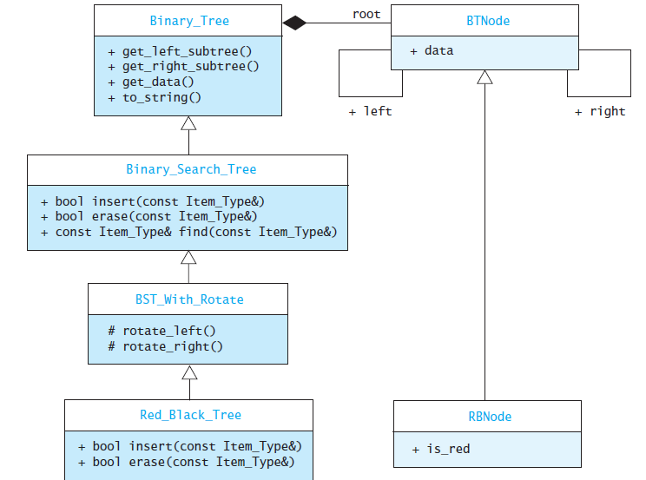
Implementation of a Red-Black Tree Class

Slide 154
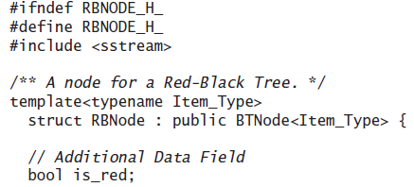
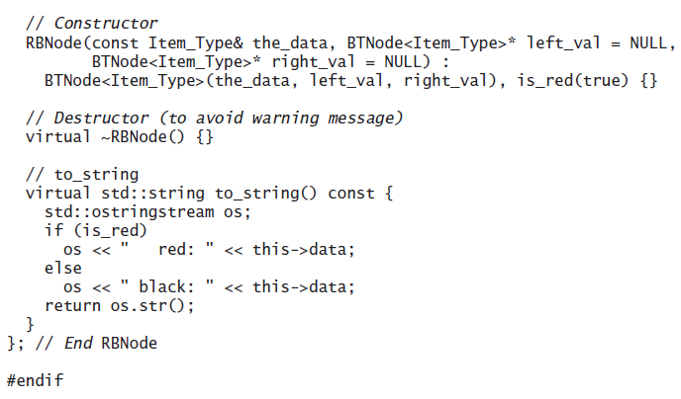
Implementation of a Red-Black Tree Class (cont.)

Slide 155
Algorithm for Red-Black Tree Insertion
The insertion algorithm can be implemented with a data structure that has a pointer to the parent of each node
The following algorithm detects the need for fix-ups from the grandparent level
Also, whenever a black node with two red children is detected on the way down the tree, it is changed to red and the children are changed to black; any resulting problems can be fixed on the way back up

Slide 156
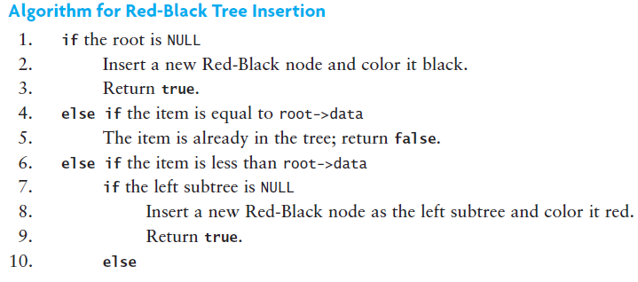
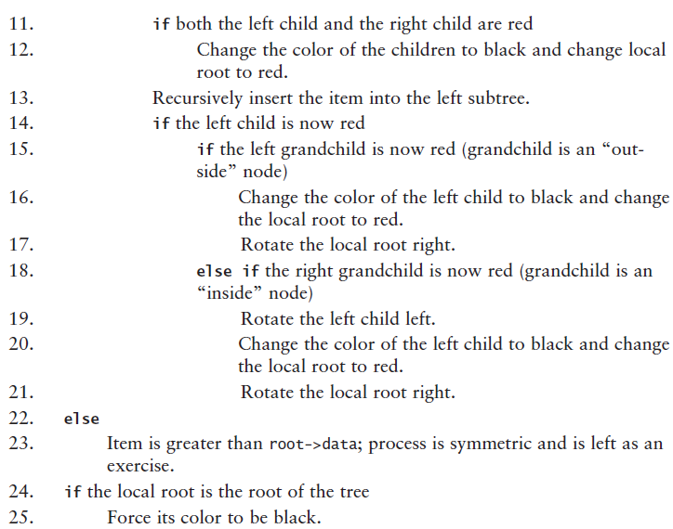
Algorithm for Red-Black Tree Insertion (cont.)

Slide 157
The insert Starter Function
template<typename Item_Type>
bool Red_Black_Tree<Item_Type>::insert(const Item_Type& item) {
if (this->root == NULL) {
RBNode<Item_Type>* new_root = new RBNode<Item_Type>(item);
new_root->is_red = false;
this->root = new_root;
return true;
}
else {
// Call the recursive insert function.
bool return_value = insert(this->root, item);
// Force the root to be black
set_red(this->root, false);
return return_value;
}
}

Slide 158
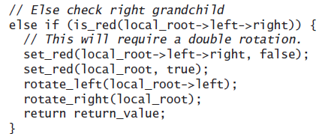
The Recursive insert Function

Slide 159
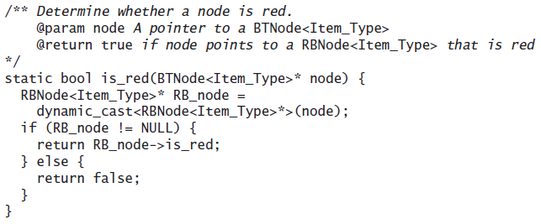
The Function is_red

Slide 160
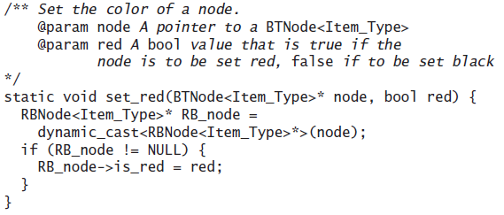
The Function set_red

Slide 161
Removal from a Red-Black Tree
Remove a node only if it is a leaf or has only one child
Otherwise, the node containing the inorder predecessor of the value being removed is removed
If the node removed is red, nothing further is done
If the node removed is black and has a red child, then the red child takes its place and is colored black
If a black leaf is removed, the black height becomes unbalanced
A programming project at the end of the chapter describes other cases

Slide 162
Performance of a Red-Black Tree
The upper limit on the height for a Red-Black tree is 2 log₂n + 2 which is still O(log n)
As with AVL trees, the average performance is significantly better than the worst-case performance
Empirical studies show that the average cost of searching a Red-Black tree built from random values is 1.002 log₂n
Red-Black trees and AVL trees both give performance close to the performance of a complete binary tree

Slide 163
Red-Black Trees vs. AVL Trees
Insertion and removal are faster for Red-Black trees
Retrieval is faster for AVL trees

Slide 164
2-3 Trees
Section 11.4

Slide 165
2-3 Trees
A 2-3 tree consists of nodes designated as either 2-nodes or 3-nodes
A 2-node is the same as a binary search tree node:
it contains a data field and references to two child nodes
one child node contains data less than the node's data value
the other child contains data greater than the node's data value
A 3-node
contains two data fields, ordered so that first is less than the second, and references to three children
One child contains data values less than the first data field
One child contains data values between the two data fields
One child contains data values greater than the second data field
All the leaves of a 2-3 tree are at the lowest level

Slide 166
2-3 Trees (cont.)

Slide 167
Searching a 2-3 Tree
Searching a 2-3 tree is very similar to searching a binary search tree.
if the local root is NULL
Return NULL; the item is not in the tree.
else if this is a 2-node
if the item is equal to the data1 field
Return the data1 field.
else if the item is less than the data1 field
Recursively search the left subtree.
else
Recursively search the right subtree.
else // This is a 3-node
if the item is equal to the data1 field
Return the data1 field.
else if the item is equal to the data2 field
Return the data2 field.
else if the item is less than the data1 field
Recursively search the left subtree.
else if the item is less than the data2 field
Recursively search the middle subtree.
else
Recursively search the right subtree.

Slide 168
Searching a 2-3 Tree (cont.)
To search for 13
7
3
11, 15
1
5
9
13
17, 19

Slide 169
Searching a 2-3 Tree (cont.)
To search for 13
Compare 13 and 7
7
3
11, 15
1
5
9
13
17, 19

Slide 170
Searching a 2-3 Tree (cont.)
To search for 13
13 is greater than 7
7
3
11, 15
1
5
9
13
17, 19

Slide 171
Searching a 2-3 Tree (cont.)
To search for 13
7
3
11, 15
Compare 13 with 11 and 15
1
5
9
13
17, 19

Slide 172
Searching a 2-3 Tree (cont.)
To search for 13
7
3
11, 15
13 is in between 11 and 15
11 < 13 < 15
1
5
9
13
17, 19

Slide 173
Searching a 2-3 Tree (cont.)
To search for 13
7
3
11, 15
1
5
9
13
17, 19
13 is in the middle child

Slide 174
Inserting an Item into a 2-3 Tree
A 2-3 tree maintains balance by being built from the bottom up, not the top down
Instead of hanging a new node onto a leaf, we insert the new node into a leaf

Slide 175
Inserting an Item into a 2-3 Tree (cont.)
Insert 15
7
3
11

Slide 176
Inserting an Item into a 2-3 Tree (cont.)
Insert 15
7
3
11
Because this node is a 2-node, we insert directly into the node creating a 3-node

Slide 177
Inserting an Item into a 2-3 Tree (cont.)
Insert 15
7
3
11, 15

Slide 178
Inserting an Item into a 2-3 Tree (cont.)
Insert 17
7
3
11, 15

Slide 179
Inserting an Item into a 2-3 Tree (cont.)
Insert 17
7
3
11, 15
Because we insert into leaves, 17 is virtually inserted into this node

Slide 180
Inserting an Item into a 2-3 Tree (cont.)
Insert 17
7
3
11, 15, 17
Because a node can't store three values, the middle value propagates up to the 2-node parent and this leaf node splits into two new 2-nodes

Slide 181
Inserting an Item into a 2-3 Tree (cont.)
Insert 17
7, 15
3
11
17

Slide 182
Inserting an Item into a 2-3 Tree (cont.)
Insert 5, 10, 20
7, 15
3
11
17

Slide 183
Inserting an Item into a 2-3 Tree (cont.)
Insert 5, 10, 20
7, 15
3, 5
11
17

Slide 184
Inserting an Item into a 2-3 Tree (cont.)
Insert 5, 10, 20
7, 15
3, 5
10, 11
17

Slide 185
Inserting an Item into a 2-3 Tree (cont.)
Insert 5, 10, 20
7, 15
3, 5
10, 11
17, 20

Slide 186
Inserting an Item into a 2-3 Tree (cont.)
Insert 13
7, 15
3, 5
10, 11
17, 20

Slide 187
Inserting an Item into a 2-3 Tree (cont.)
Insert 13
7, 15
3, 5
10, 11, 13
17, 20

Slide 188
Inserting an Item into a 2-3 Tree (cont.)
Insert 13
7, 15
3, 5
10, 11, 13
17, 20
Since a node with three values is a virtual node, move the middle value up and split the remaining values into two nodes

Slide 189
Inserting an Item into a 2-3 Tree (cont.)
Insert 13
7, 11, 15
3, 5
10
13
17, 20
Repeat

Slide 190
Inserting an Item into a 2-3 Tree (cont.)
11
Insert 13
7, 15
3, 5
10
13
17, 20
Move the middle value up

Slide 191
Inserting an Item into a 2-3 Tree (cont.)
11
Insert 13
7, 15
3, 5
10
13
17, 20
Split the remaining values into two nodes

Slide 192
Inserting an Item into a 2-3 Tree (cont.)
11
Insert 13
7
15
3, 5
10
13
17, 20
Split the remaining values into two nodes

Slide 193
Algorithm for Insertion into a 2-3 Tree
if the root is NULL
Create a new 2-node that contains the new item.
else if the item is in the local root
Return false
else if the local root is a leaf
if the local root is a 2-node
Expand the 2-node to a 3-node and insert the item
else
Split the 3-node (creating two 2-nodes) and pass the new parent and right child back up the recursion chain
else
(cont.)

Slide 194
Algorithm for Insertion into a 2-3 Tree (cont.)
if the item is less than the smaller item in the local root
Recursively insert into the left child.
else if the local root is a 2-node
Recursively insert into the right child.
else if the item is less than the larger item in the local root
Recursively insert into the middle child.
else
Recursively insert into the right child.
if a new parent was passed up from the previous level of recursion
if the new parent will be the tree root
Create a 2-node whose data item is the passed-up parent, left child is the old root, and right child is the passed-up child. This 2-node becomes the new root
else
Recursively insert the new parent at the local root
24. Return true.

Slide 195
Insertion Example
Create a 2-3 tree using the words “The quick brown fox jumps over the lazy dog”

Slide 196
Insertion Example (cont.)
The

Slide 197
Insertion Example (cont.)
The, quick

Slide 198
Insertion Example (cont.)
The, brown, quick

Slide 199
Insertion Example (cont.)
brown
The
quick

Slide 200
Insertion Example (cont.)
brown
The
fox, quick

Slide 201
Insertion Example (cont.)
brown
The
fox, jumps, quick

Slide 202
Insertion Example (cont.)
brown, jumps
The
fox
quick

Slide 203
Insertion Example (cont.)
brown, jumps
The
fox
over, quick

Slide 204
Insertion Example (cont.)
brown, jumps
The
fox
over, quick, the

Slide 205
Insertion Example (cont.)
brown, jumps, quick
The
fox
over
the

Slide 206
Insertion Example (cont.)
jumps
brown
quick
The
fox
over
the

Slide 207
Insertion Example (cont.)
jumps
brown
quick
The
fox
lazy, over
the

Slide 208
Insertion Example (cont.)
jumps
brown
quick
The
dog, fox
lazy, over
the

Slide 209
Analysis of 2-3 Trees and Comparison with Balanced Binary Trees
2-3 trees do not require the rotations needed for AVL and Red-Black trees
The number of items that a 2-3 tree of height h can hold is between 2^{h} -1 (all 2 nodes) and 3^{h} – 1 (all 3-nodes)
Therefore, the height of a 2-3 tree is between log₃ n and log₂ n
The search time is O(log n) -- logarithms are all related by a constant factor, and constant factors are ignored in big-O notation

Slide 210
Removal from a 2-3 Tree
Removing an item from a 2-3 tree is generally the reverse of the insertion process
If the item to be removed is in a leaf with two items, simply delete the item
If it’s not in a leaf, remove it by swapping it with its inorder predecessor in a leaf node and deleting it from the leaf node
If removing an item from a leaf causes the leaf to become empty,
items from the sibling and parent can be redistributed into that leaf
or the leaf can be merged with its parent and sibling nodes

Slide 211
Removal from a 2-3 Tree (cont.)
7
3
11, 15
1
5
9
13
17, 19

Slide 212
Removal from a 2-3 Tree (cont.)
Remove 13
7
3
11, 15
1
5
9
13
17, 19

Slide 213
Removal from a 2-3 Tree (cont.)
The node becomes empty
7
3
11, 15
1
5
9
17, 19

Slide 214
Removal from a 2-3 Tree (cont.)
Merge 15 with a remaining child
7
3
11, 15
1
5
9
17, 19

Slide 215
Removal from a 2-3 Tree (cont.)
Merge 15 with a remaining child
7
3
11
1
5
9
15, 17, 19

Slide 216
Removal from a 2-3 Tree (cont.)
Split the node and move the middle value (17) up
7
3
11
1
5
9
15, 17, 19

Slide 217
Removal from a 2-3 Tree (cont.)
Split the node and move the middle value (17) up
7
3
11, 17
1
5
9
15
19

Slide 218
Removal from a 2-3 Tree (cont.)
Remove 11
7
3
11, 17
1
5
9
15
19

Slide 219
Removal from a 2-3 Tree (cont.)
Because 11 is not in a leaf, replace it with its leaf predecessor (9)
7
3
17
1
5
9
15
19

Slide 220
Removal from a 2-3 Tree (cont.)
Because 11 is not in a leaf, replace it with its leaf predecessor (9)
7
3
9, 17
1
5
15
19

Slide 221
Removal from a 2-3 Tree (cont.)
The left leaf is now empty. Merge the parent (9) into its right child (15)
7
3
9, 17
1
5
15
19

Slide 222
Removal from a 2-3 Tree (cont.)
The left leaf is now empty. Merge the parent (9) into its right child (15)
7
3
17
1
5
9, 15
19

Slide 223
Removal from a 2-3 Tree (cont.)
Remove 1
7
3
17
1
5
9, 15
19

Slide 224
Removal from a 2-3 Tree (cont.)
Remove 1
7
3
17
5
9, 15
19

Slide 225
Removal from a 2-3 Tree (cont.)
Merge the parent (3) with its right child (5)
7
3
17
5
9, 15
19

Slide 226
Removal from a 2-3 Tree (cont.)
Merge the parent (3) with its right child (5)
7
17
3, 5
9, 15
19

Slide 227
Removal from a 2-3 Tree (cont.)
Repeat on the next level.
Merge the parent (7) with its right child (17)
7
17
3, 5
9, 15
19

Slide 228
Removal from a 2-3 Tree (cont.)
Repeat on the next level.
Merge the parent (7) with its right child (17)
7, 17
9, 15
19
3, 5

Slide 229
Removal from a 2-3 Tree (cont.)
Repeat on the next level.
Merge the parent (7) with its right child (17)
7, 17
3, 5
9, 15
19

Slide 230
2-3-4 Trees and B-Trees
Section 11.5

Slide 231
B-Trees and 2-3-4 Trees
The 2-3 tree was the inspiration for the more general B-tree which allows up to n children per node, where n may be a very large number
The B-tree was designed for building indexes to very large databases stored on a hard disk

Slide 232
2-3-4 Trees
2-3-4 trees are a special case of the B-tree where order is fixed at 4
A node in a 2-3-4 tree is called a 4-node
A 4-node has space for three data items and four children

Slide 233
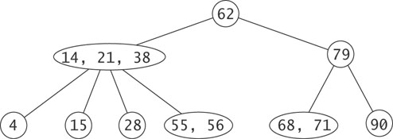
2-3-4 Tree Example

Slide 234
2-3-4 Trees (cont.)
Fixing the capacity of a node at three data items simplifies the insertion logic
A search for a leaf is the same as for a 2-3 tree or B-tree
If a 4-node is encountered, we split it
When we reach a leaf, we are guaranteed to find room to insert an item

Slide 235
Insertion into a 2-3-4 Tree
62
14, 21, 38
79
4
15
28
55, 56
68, 71
90

Slide 236
Insertion into a 2-3-4 Tree (cont.)
62
A number larger than 62 is inserted into one of this subtree's leaf nodes
14, 21, 38
79
4
15
28
55, 56
68, 71
90

Slide 237
Insertion into a 2-3-4 Tree (cont.)
62
14, 21, 38
79
4
15
28
55, 56
68, 71
90
A number between 63 and 78, inclusive, is inserted into this 3-node making it a 4-node

Slide 238
Insertion into a 2-3-4 Tree (cont.)
62
14, 21, 38
79
4
15
28
55, 56
68, 71
90
A number larger than 79 is inserted into this 2-node making it a 3-node

Slide 239
Insertion into a 2-3-4 Tree (cont.)
Inserting 25
62
14, 21, 38
79
4
15
28
55, 56
68, 71
90

Slide 240
Insertion into a 2-3-4 Tree (cont.)
As soon as a 4-node is encountered, split it and move the middle value into the parent
62
14, 21, 38
79
4
15
28
55, 56
68, 71
90

Slide 241
Insertion into a 2-3-4 Tree (cont.)
As soon as a 4-node is encountered, split it and move the middle value into the parent
21, 62
14
38
79
4
15
28
55, 56
68, 71
90

Slide 242
Insertion into a 2-3-4 Tree (cont.)
21, 62
14
38
79
4
15
25, 28
55, 56
68, 71
90
Then add the value (25) in a leaf node

Slide 243
Insertion into a 2-3-4 Tree (cont.)
21, 62
14
38
79
4
15
25, 28
55, 56
68, 71
90
This immediate split guarantees that a parent will not be a 4-node, and we will not need to propagate a child or its parent back up the recursion chain. The recursion becomes tail recursion.

Slide 244
Insertion into a 2-3-4 Tree (cont.)
21, 62
14
38
79
4
15
25, 28
55, 56
68, 71
90
25 could have been inserted into the leaf node without splitting the parent 4-node, but always splitting a 4-node when it is encountered simplifies the algorithm with minimal impact on overall performance

Slide 245
Insertion into a 2-3-4 Tree (cont.)
The quick brown fox jumps over the lazy dog
brown
The
quick

Slide 246
Insertion into a 2-3-4 Tree (cont.)
The quick brown fox jumps over the lazy dog
brown
The
fox, quick

Slide 247
Insertion into a 2-3-4 Tree (cont.)
The quick brown fox jumps over the lazy dog
brown
The
fox, jumps, quick

Slide 248
Insertion into a 2-3-4 Tree (cont.)
The quick brown fox jumps over the lazy dog
brown, jumps
The
fox
quick

Slide 249
Insertion into a 2-3-4 Tree (cont.)
The quick brown fox jumps over the lazy dog
brown, jumps
The
fox
over, quick

Slide 250
Insertion into a 2-3-4 Tree (cont.)
The quick brown fox jumps over the lazy dog
brown, jumps
The
fox
over, quick, the

Slide 251
Insertion into a 2-3-4 Tree (cont.)
The quick brown fox jumps over the lazy dog
brown, jumps, quick
The
fox
lazy, over
the

Slide 252
Insertion into a 2-3-4 Tree (cont.)
The quick brown fox jumps over the lazy dog
jumps
brown
quick
The
fox
lazy, over
the

Slide 253
Insertion into a 2-3-4 Tree (cont.)
The quick brown fox jumps over the lazy dog
jumps
brown
quick
The
dog, fox
lazy, over
the

Slide 254
Implementation of the Two_Three_Four_Tree Class
Instead of defining specialized nodes for a 2-3-4 tree, we can define a general node that holds up to CAP - 1 data items and CAP children, where CAP is a template parameter
The information will be stored in the array data of size CAP - 1, and the pointers to the children will be stored in the array child of size CAP
The information values will be sorted so that data[0] < data[1] < data[2] < . . .
The data field size will indicate how many data values are in the node
The children will be associated with the data values such that child[0] points to the subtree with items smaller than data[0], child[size] points to the subtree with items larger than data[size - 1], and for 0 < i < size, child[i] points to items greater than data[i - 1] and smaller than data[i]

Slide 255
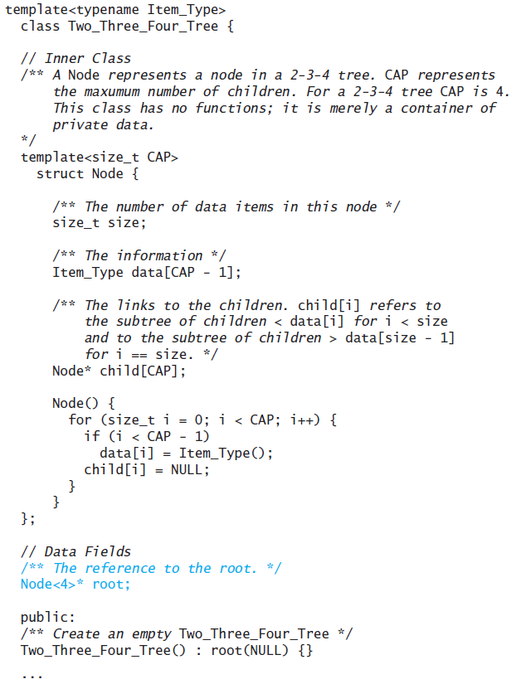
Implementation of the Two_Three_Four_Tree Class (cont.)

Slide 256
Algorithm for Insertion into a 2-3-4 Tree
1. if the root is NULL
2. Create a new 2-node with the item
3. Return true
4. if the root is a 4-node
5. Split it into two 2-nodes, making the middle value the new root.
6. Set index to 0
7. while the item is greater than data[index]
8. Increment index
9. if the item is equal to data[index]
10. Return false
11. else
...

Slide 257
Algorithm for Insertion into a 2-3-4 Tree (cont.)
12. if child[index] is NULL
13. Insert the item into the local root at index, moving the existing data and child values to the right
14. else if child[index] does not reference a 4-node
15. Recursively continue the search with child[index] as the local root
16. else
17. Split the node referenced by child[index]
18. Insert the parent into the local root at index
19. if the new parent is equal to the item, return false
20. if the item is less than the new parent
21. Recursively continue the search with child[index] as the local root
22. else
23. Recursively continue the search with child[index + 1] as the local root

Slide 258
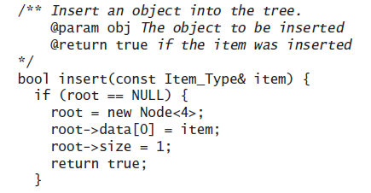
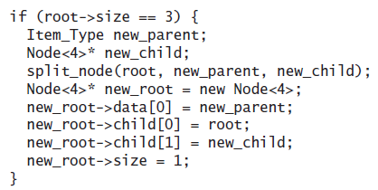
The insert Starter Function

Slide 259
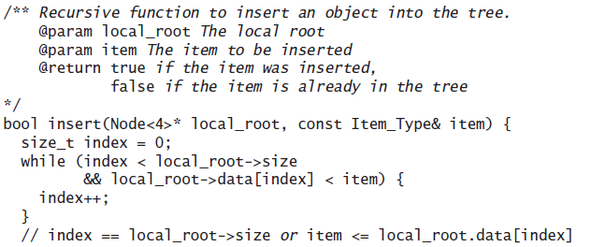
Recursive insert Function

Slide 260
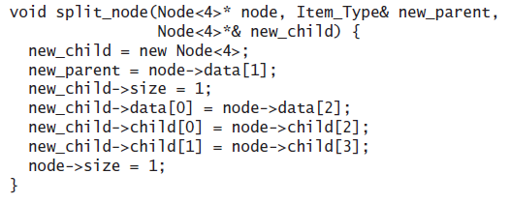
The split-node Function

Slide 261
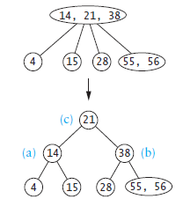
The split_node Function

Slide 262
Recursive insert-into-node Function

Slide 263
Relating 2-3-4 Trees to Red-Black Trees
A Red-Black tree is a binary-tree equivalent of a 2-3-4 tree
A 2-node is a black node

Slide 264
Temporary color-change slide
On the next four slides, consider the blue circles to be red circles

Slide 265
Relating 2-3-4 Trees to Red-Black Trees (cont.)
A 4-node is a black node with two red (blue) children

Slide 266
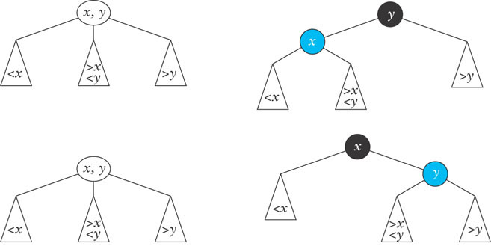
Relating 2-3-4 Trees to Red-Black Trees (cont.)
A 3-node can be represented as either a black node with a left red (blue) child or a black node with a right red (blue) child

Slide 267
Relating 2-3-4 Trees to Red-Black Trees (cont.)
Inserting a value z greater than y in this tree:
yields this tree:

Slide 268
Relating 2-3-4 Trees to Red-Black Trees (cont.)
Inserting value z that is between x and y

Slide 269
B-Trees
A B-tree allows a maximum of CAP – 1 data items in each node
Each node (except the root) has between (CAP – 1)/2 and CAP – 1 data items
An example with CAP equal to 5 follows

Slide 270
B-Trees (cont.)
10
22
30
40
13
15
18
20
32
35
38
5
7
8
26
27
42
46

Slide 271
B-Trees (cont.)
The maximum number of children is the order of the B-tree, which we represent as the variable order
10
22
30
40
13
15
18
20
32
35
38
5
7
8
26
27
42
46

Slide 272
B-Trees (cont.)
The order of the B-tree below is 5
10
22
30
40
13
15
18
20
32
35
38
5
7
8
26
27
42
46

Slide 273
B-Trees (cont.)
The maximum number of data items in a node is 1 less than the number of children (the order)
10
22
30
40
13
15
18
20
32
35
38
5
7
8
26
27
42
46

Slide 274
B-Trees (cont.)
Other than the root, each node has between order/2 and order - 1 data items
10
22
30
40
13
15
18
20
32
35
38
5
7
8
26
27
42
46

Slide 275
B-Trees (cont.)
The data items in each node are in increasing order
10
22
30
40
13
15
18
20
32
35
38
5
7
8
26
27
42
46

Slide 276
B-Trees (cont.)
The first link from a node connects it to a subtree with values smaller than the parent's smallest value
10
22
30
40
13
15
18
20
32
35
38
5
7
8
26
27
42
46

Slide 277
B-Trees (cont.)
The last link from a node connects it to a subtree with values greater than the parent's largest value
10
22
30
40
13
15
18
20
32
35
38
5
7
8
26
27
42
46

Slide 278
B-Trees (cont.)
The other links are to subtrees with values between each pair of consecutive values in the parent node.
10
22
30
40
13
15
18
20
32
35
38
5
7
8
26
27
42
46

Slide 279
B-Trees (cont.)
B-Trees were developed to store indexes to databases on disk storage.
disk storage is broken into blocks
the nodes of a B-tree are sized to fit in a block
each disk access to the index retrieves exactly one B-tree node
the time to retrieve a block off the disk is large compared to the time to process it in memory
by making tree nodes as large as possible, we reduce the number of disk accesses required to find an item in the index
Assuming a block can store a node for a B-tree of order 200, each node would store at least 100 items.
This enables 100⁴ or 100 million items to be accessed in a B-tree of height 4

Slide 280
B-Tree Insertion
10
22
30
40
13
15
18
20
32
35
38
5
7
8
26
27
42
46
Similar to 2-3 trees, insertions take place in leaves

Slide 281
B-Tree Insertion (cont.)
10
22
30
40
13
15
18
20
32
35
38
5
7
8
26
27
42
46
A value less than 10 would be inserted here

Slide 282
B-Tree Insertion (cont.)
10
22
30
40
A value between 10 and 22 here
13
15
18
20
32
35
38
5
7
8
26
27
42
46

Slide 283
B-Tree Insertion (cont.)
10
22
30
40
13
15
18
20
32
35
38
5
7
8
26
27
42
46
A value between 22 and 30 here
and so on . . .

Slide 284
B-Tree Insertion (cont.)
Insertion of 39
10
22
30
40
13
15
18
20
32
35
38
39
5
7
8
26
27
42
46

Slide 285
B-Tree Insertion (cont.)
10
22
30
40
13
15
18
20
32
35
38
39
5
7
8
26
27
42
46
If a leaf to receive the insertion is full, it is split into two nodes, each containing approximately half the items, and the middle item is passed up to the split node's parent

Slide 286
B-Tree Insertion (cont.)
10
22
30
40
13
15
18
20
32
35
38
39
5
7
8
26
27
42
46
If the parent is full, it is split and its middle item is passed up to its parent, and so on

Slide 287
B-Tree Insertion (cont.)
Insert 17
10
22
30
40
13
15
18
20
32
35
38
39
5
7
8
26
27
42
46

Slide 288
B-Tree Insertion (cont.)
10
22
30
40
13
15
17
18
20
32
35
38
39
5
7
8
26
27
42
46

Slide 289
B-Tree Insertion (cont.)
10
17
22
30
40
13
15
18
20
32
35
38
39
5
7
8
26
27
42
46

Slide 290
B-Tree Insertion (cont.)
22
10
17
30
40
13
15
18
20
32
35
38
39
5
7
8
26
27
42
46

Slide 291
Implementing the B-Tree
In the 2-3-4 tree implementation, we made the Node class a template, giving it the parameter CAP that represented the maximum number of children. We can use this same Node class in the B_Tree, but now the template parameter applies to the whole class. Thus we begin the declaration of the B_Tree class as follows:
template<typename Item_Type, size_t CAP>
class B_Tree {
// Inner Class
/** A Node represents a node in a B-tree. CAP represents the maxumum number of children. This class has no functions; it is merely a container of private data.
*/
struct Node {
...
};
// Data Fields
/** The reference to the root. */
Node* root;

Slide 292
Implementing the B-Tree (cont.)
The definition of the Node class is the same as for Class Two_Three_Four-Tree.
The insert function is very similar to that for the 2-3 and 2-3-4 trees
It searches the current Node for the item until it reaches a leaf, and then inserts the item into that leaf
If the leaf is full, it is split
In the 2-3 tree we described this process as a virtual insertion into the full leaf and then using the middle data value as the parent of the split-off node
This parent value was then inserted into the parent node during the return process of the recursion
In the 2-3-4 tree we avoided this complication by splitting a full node during the search process, thus the search process never terminated with a full node

Slide 293
Implementing the B-Tree (cont.)
If the maximum number of children is odd (and thus there is an even number of data values), splitting on the way up the recursion chain results in the split node and the split-off node having equal numbers of data values
If the split on the way down is applied to this case, the split node and split-off node can become unbalanced, with one node having one less than half the values and the other having one more
If the number of children is even (and thus there are an odd number of data values), splitting on the way down is simpler, since the center value is well-defined, while after the virtual insertion there is a choice for the center value
However, the result has to be that either split node or the split-off node has one more data value than the other

Slide 294
Algorithm for Insertion into a B-Tree
if the root is NULL
Create a new Node that contains the inserted item
else search the local root for the item
if the item is in the local root
Return false
else
if the local root is a leaf
if the local root is not full
Insert the new item
Return NULL as the new_child and true to indicate successful insertion
else
Split the local root
Return the new_parent and a pointer to the new_child and true to indicate successful insertion
else

Slide 295
Algorithm for Insertion into a B-Tree (cont.)
15. Recursively call the insert function
16. if the returned new_child is not NULL
17. if the local root is not full
18. Insert the new_parent and a pointer to the new_child into the local root
19. Return NULL as the new_child and true to indicate successful insertion
20. else
21. Split the local root.
22. Return the new_parent and a pointer to the new_child and true to indicate successful insertion
23. else
24. Return the success/fail indicator for the insertion.

Slide 296
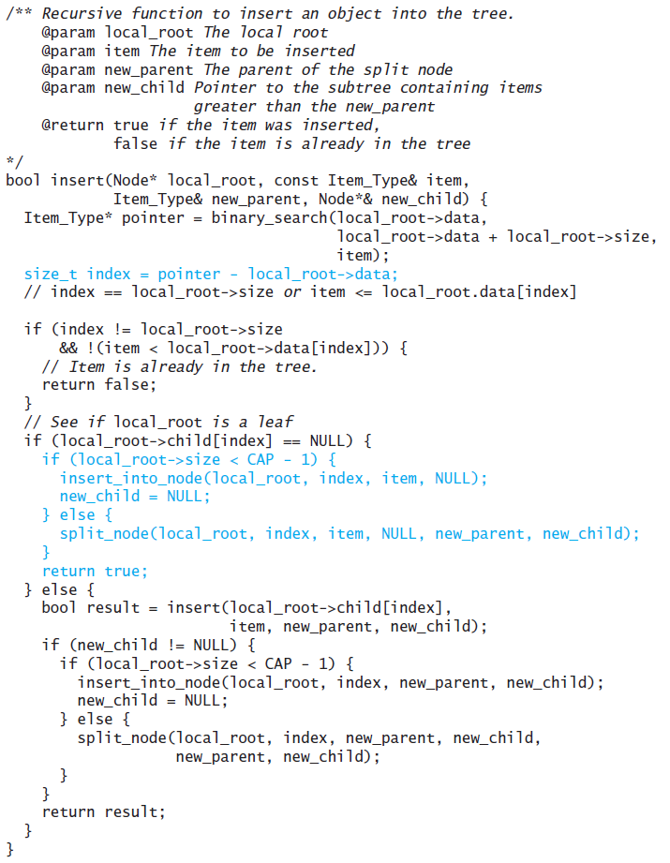
Code for the insert Function

Slide 297
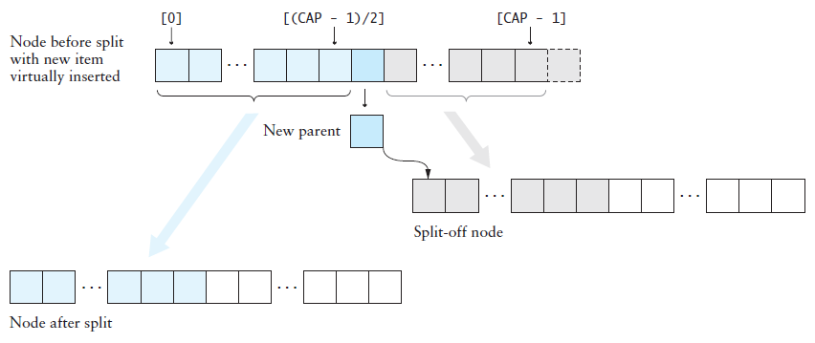
The split_node Function

Slide 298
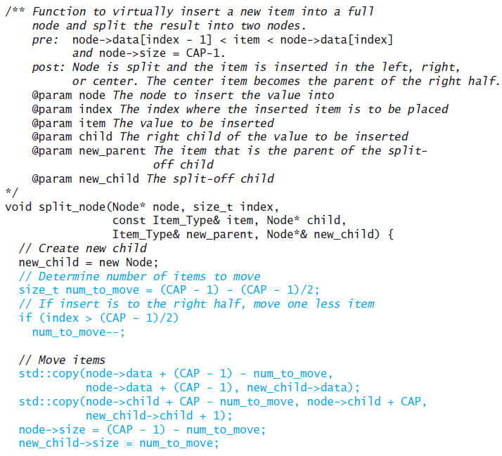
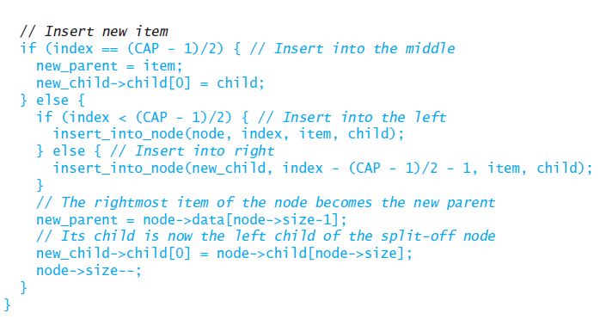
The split_node Function (cont.)

Slide 299
Removal from a B-Tree
Removing an item is a generalization of removing an item from a 2-3 tree
The simplest removal is deletion from a leaf
When an item is removed from an interior node, it must be replaced by its inorder predecessor (or successor) in a leaf
If removing an item from a leaf results in the leaf being less than half full, redistribution needs to occur

Slide 300
Removal from a B-Tree (cont.)
Remove 40
22
10
17
30
40
13
15
18
20
32
35
38
39
5
7
8
26
27
42
46

Slide 301
Removal from a B-Tree (cont.)
Remove 40
22
10
17
30
40
Replace 40 with its inorder predecessor
13
15
18
20
32
35
38
39
5
7
8
26
27
42
46

Slide 302
Removal from a B-Tree (cont.)
Remove 40
22
10
17
30
39
13
15
18
20
32
35
38
5
7
8
26
27
42
46

Slide 303
Removal from a B-Tree (cont.)
22
10
17
30
39
13
15
18
20
32
35
38
5
7
8
26
27
42
46

Slide 304
Removal from a B-Tree (cont.)
Remove 18
22
10
17
30
39
13
15
18
20
32
35
38
5
7
8
26
27
42
46

Slide 305
Removal from a B-Tree (cont.)
Remove 18
22
10
17
30
39
13
15
20
32
35
38
5
7
8
Only one item is left in the node, which violates a property of the B-tree
26
27
42
46

Slide 306
Removal from a B-Tree (cont.)
Remove 18
22
10
17
30
39
13
15
20
32
35
38
5
7
8
We merge it and its parent with its sibling
26
27
42
46

Slide 307
Removal from a B-Tree (cont.)
Remove 18
22
10
30
39
13
15
17
20
32
35
38
5
7
8
26
27
42
46

Slide 308
Removal from a B-Tree (cont.)
Remove 18
22
10
30
39
This node now has only 1 item
13
15
17
20
32
35
38
5
7
8
26
27
42
46

Slide 309
Removal from a B-Tree (cont.)
Remove 18
22
10
30
39
We merge it with its parent and its sibling
13
15
17
20
32
35
38
5
7
8
26
27
42
46

Slide 310
Removal from a B-Tree (cont.)
Remove 18
10
22
30
39
13
15
17
20
32
35
38
5
7
8
26
27
42
46

Slide 311
Removal from a B-Tree (cont.)
10
22
30
39
13
15
17
20
32
35
38
5
7
8
26
27
42
46

Slide 312
B+ Trees
As stated earlier, the B-tree was developed to create indexes for databases
the Node is stored on a disk block
the pointers are pointers to disk blocks instead of being memory addresses
the Item_Type is a key-value pair where the value is also a pointer to a disk block
Since in the leaf nodes all child pointers are NULL, there is a significant waste of space

Slide 313
B+ Trees (cont.)
A B+ tree addresses this wasted space
In a B+ tree,
the leaves contain the keys and pointers to their corresponding values
the internal nodes contain only keys and pointers to the children
In the B-tree there are CAP pointers to children and CAP - 1 values
In the B+ tree the parent’s value is repeated as the first value; thus there are CAP pointers and CAP keys

Slide 314
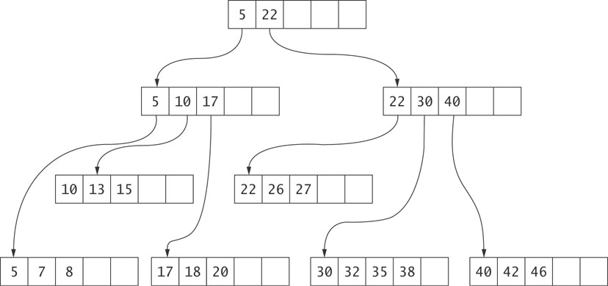
B+ Trees (cont.)

